Slide 1
KODA Camp! Getting Started
Things to consider when starting a new KODA Camp
Bert Pickell, June 3, 2003

Slide 2
Bert Pickell
A little about me
Mother and Father, Deaf. Mom’s side has many deaf in the extended family.
Attended my first CODA conference in 1995 (NC), it changed my life.
Masters degree in Education, spent 10 years as a teacher of the deaf.
Strong desire to create a camp program for KODA kids so they could learn what I did, but at a much earlier age.

Slide 3
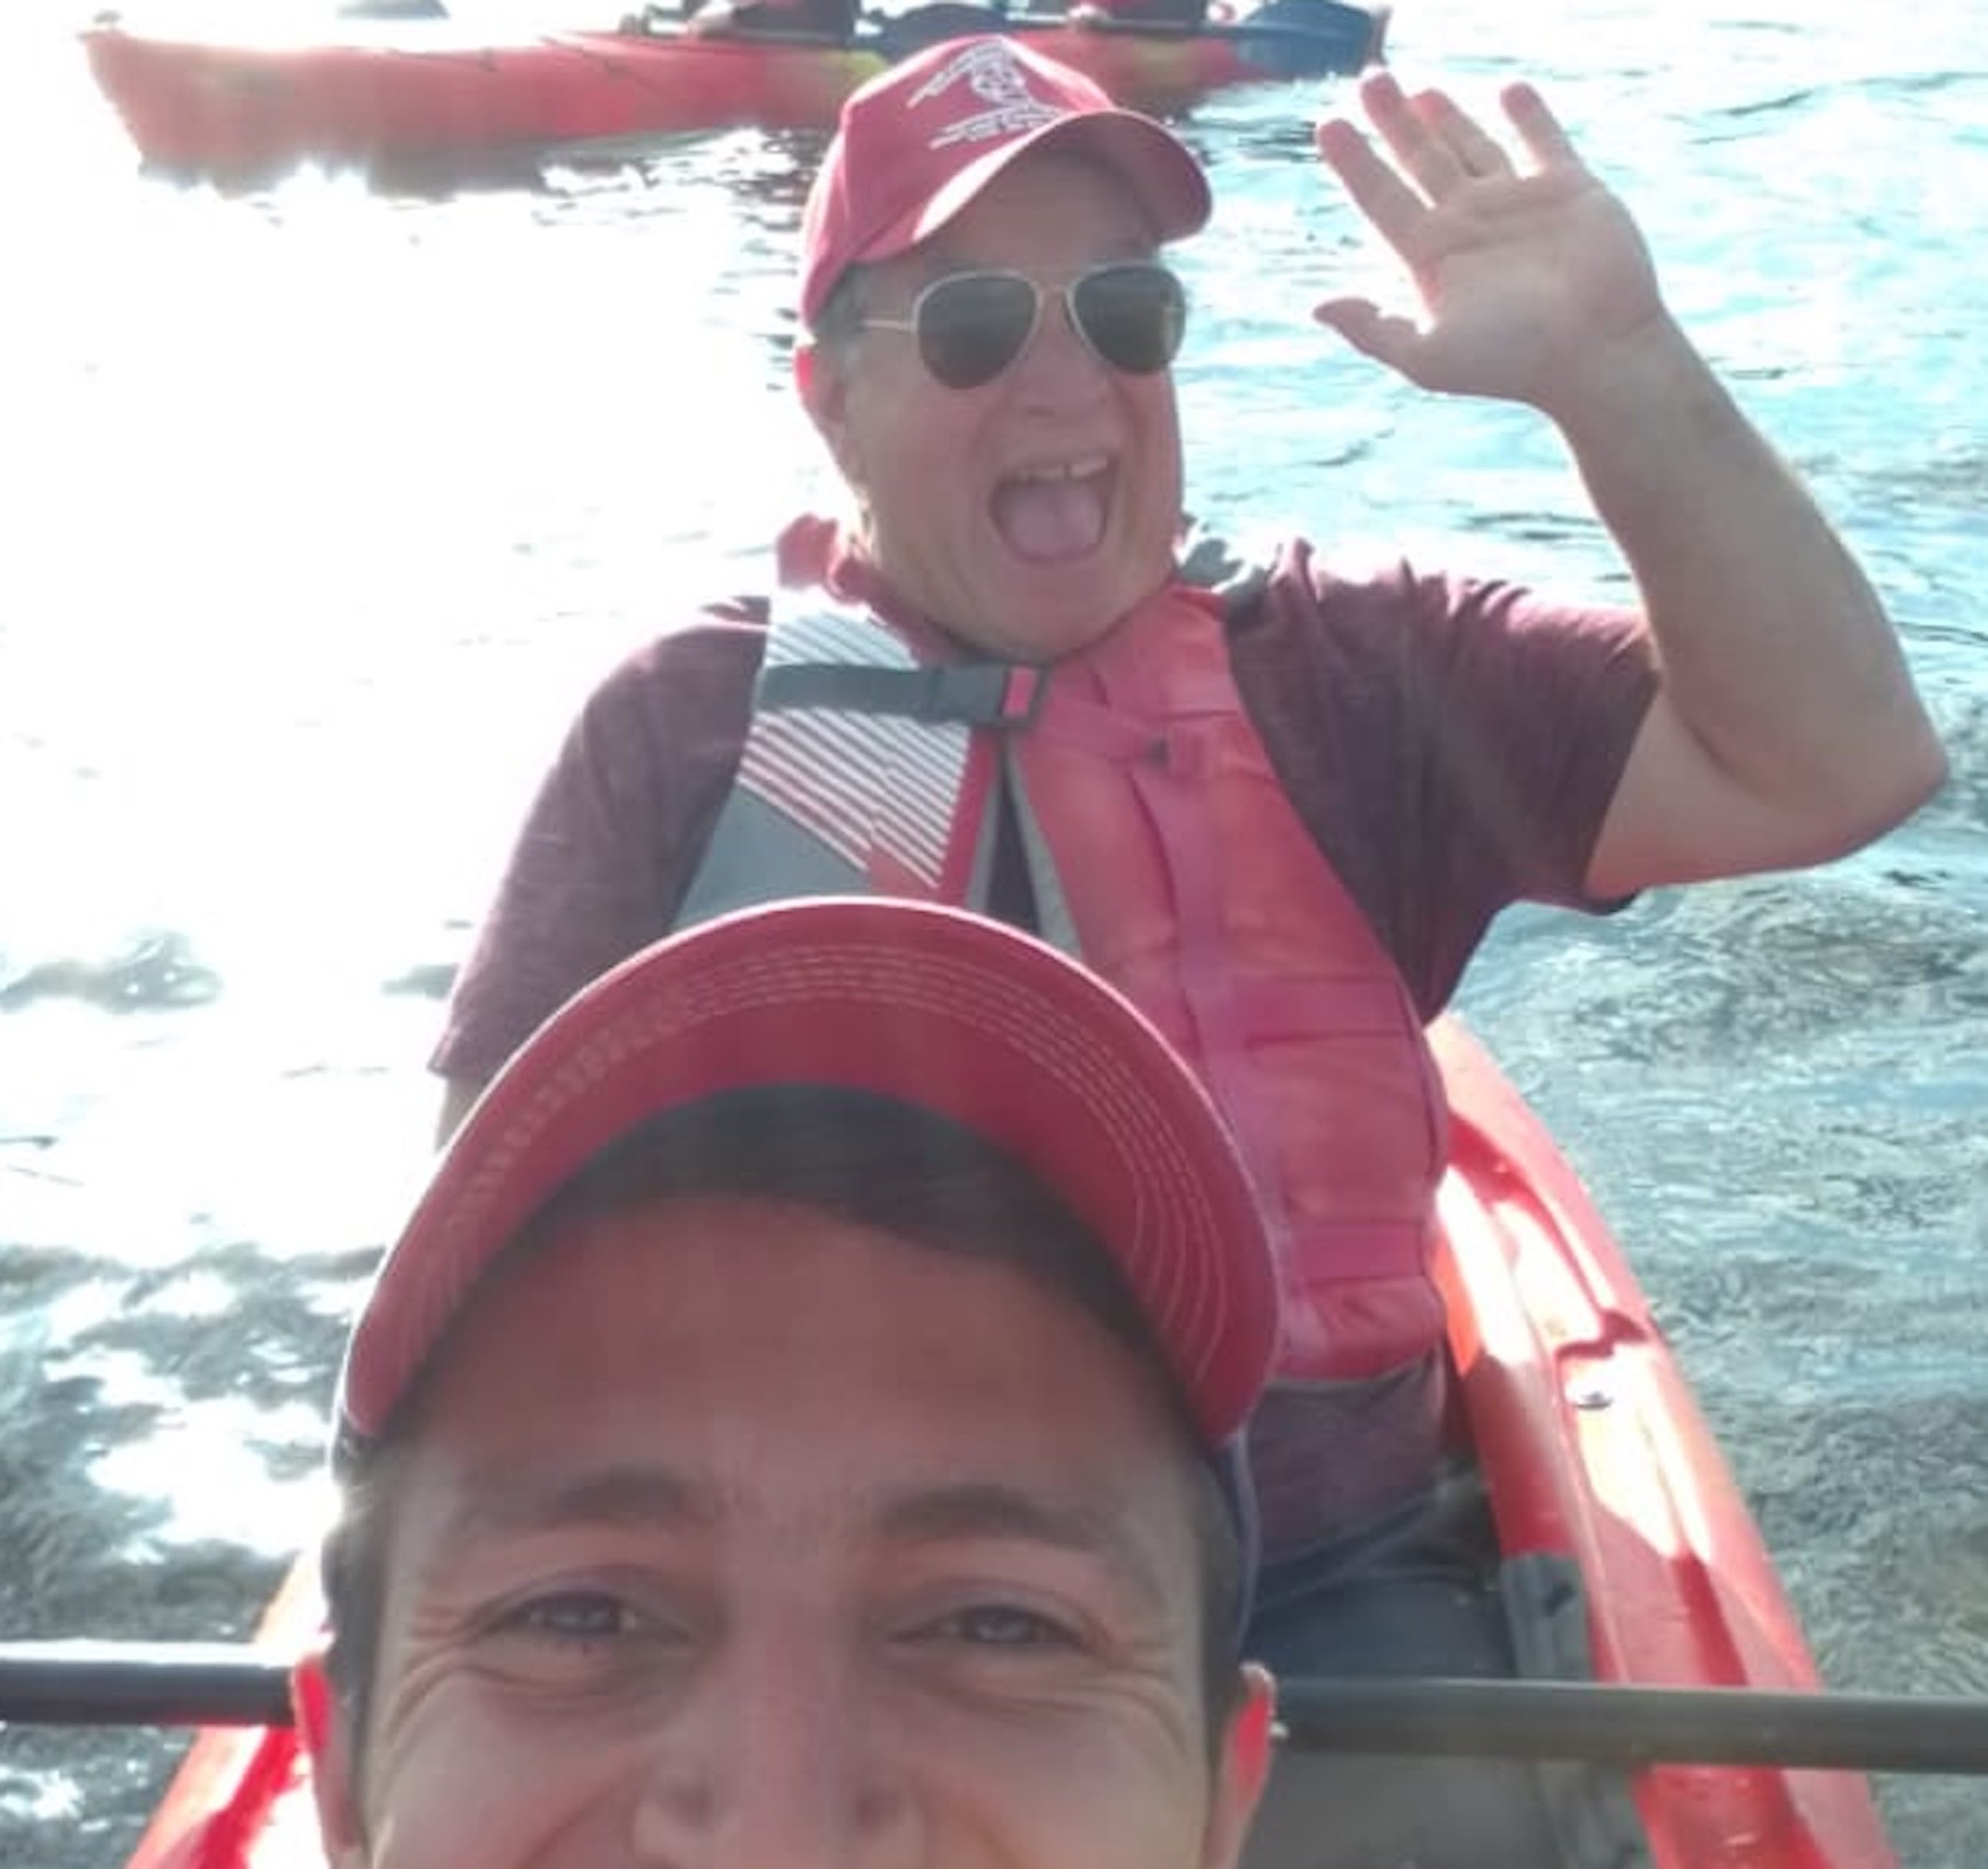
Kayaking Fun
Bert and Javier

Slide 4
  Bert Pickell
A little more about me
Talked to many people and finally connected with Lisa Flynn at Camp Mark 7, I was hired to be the first KODA Camp director and served there for 10 years.
Started additional KODA camps in South Dakota, Wisconsin and Arizona.
Still actively involved in creating the Arizona camp
Celebrating 25 years of involvement with KODA Camps in the United States.

Slide 5
KODA Camps in USA
A brief history
Camp Mark 7 - established in 1998
Camp Grizzly - established in 1999
KODA West - Established 2007
KODA Midwest - established in 2008

Slide 6
Camper Story
Growing up, I knew that I was different. However, I didn’t know how special being different was. I just assumed that everyone understood what my life was like with Deaf parents. But I struggled with my friends and felt always a part of me missing. They didn’t know how to sign or what I would go through. My parents heard about Koda Camp Midwest and signed me up. Every day I am so thankful they did. I first attended at 9 years old in 2007 and realized that every single camper was exactly like me. I never felt more at home. The immediate connections I made was so incredible. At 9 years old I felt a sense of peace I didn’t know existed. At the end of the two weeks I knew I needed to keep coming back. My parents understood and I attended every year until I was 16 and it was my last year as a camper. Every summer was a time to celebrate coming “home” at camp. At the end of the two weeks it felt like I had to leave it behind but I always had the special memories and cherish the friendships I made at camp. Without it, I wouldn’t have discovered my passion for the deaf and coda community. I love and am so proud of being a coda because I got the chance to be a koda camper.
Karissa Caddy

Slide 7
KODA Camps in USA (continued)
A brief history
KODA Southwest - established 2023
  New camp set up by Bert Pickell working with Deaf parents in the Phoenix/Tuscon area.
  Two week programs for KODA children
  Fosters identity development of KODA children

Slide 8
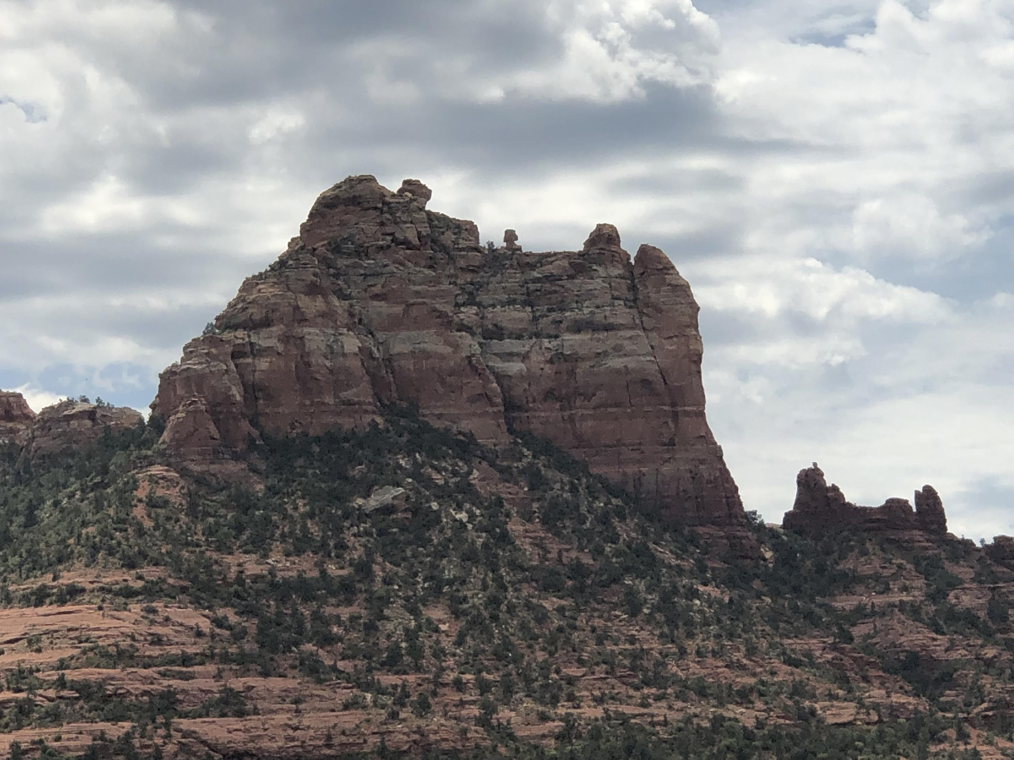
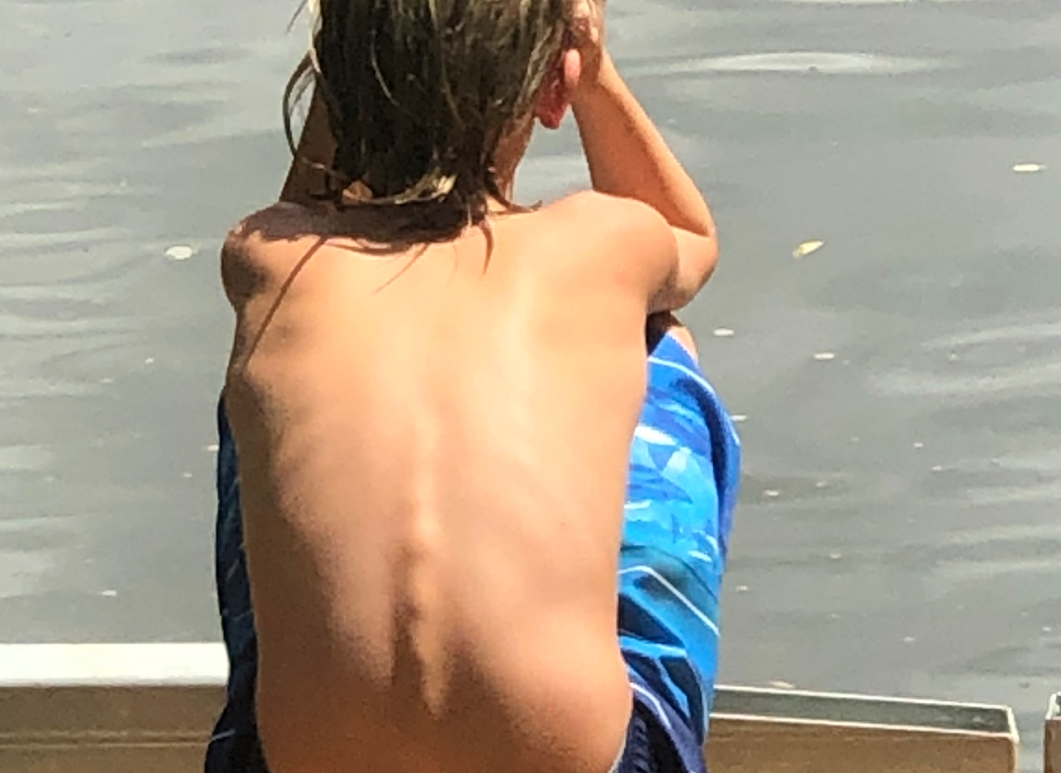
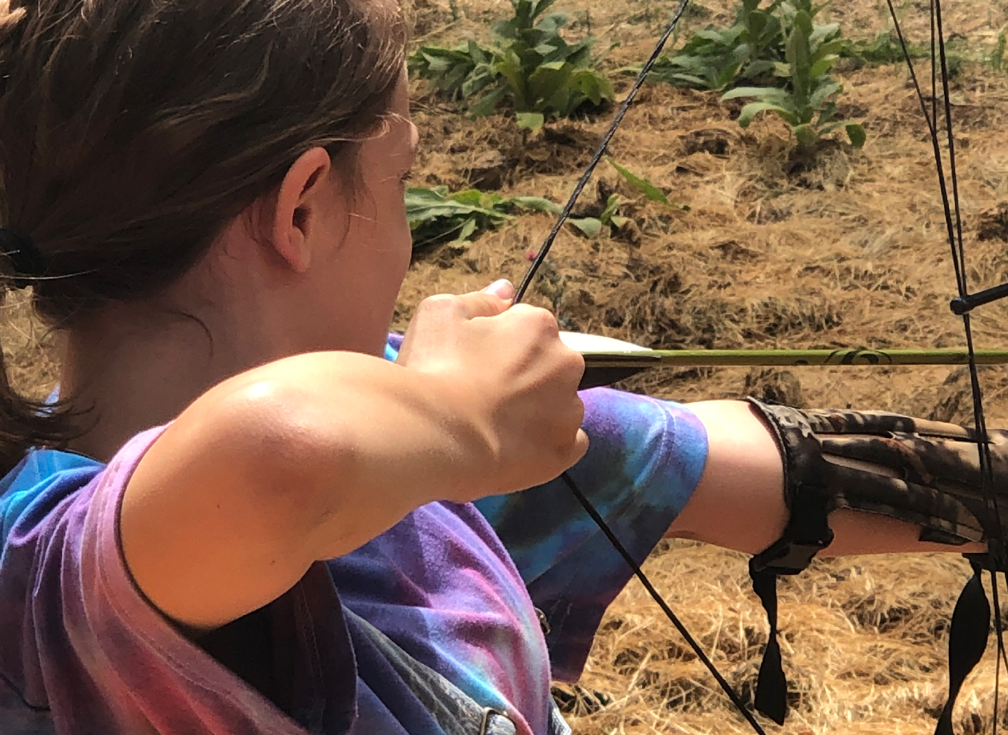

Slide 9
Staff Story
I've made observations of your camp programs at CM7.
Several things that happened nearly all of them were:
In the beginning of week many sat alone..
By end of program, they cried, hugged hard saying goodbye, but, they all made life- long friends keeping in touch thru the years.
They've also experienced they ARE NOT alone and realized how the bi- cultural dynamics they endured now makes sense.
Billy S. Allen, Waterfront Director at Camp Mark 7 for several years

Slide 10
General Principles
Deaf Community and CODA Community Involvement
Success is improved when Deaf people and CODAs work together to create the camp. Each perspective is critical to building a program that addresses the needs of that community.
Deaf parent involvement creates transparency, trust, understanding and collaborative relationship.
Deaf parent involvement ensures more kids attending (word of mouth has always been the best marketing)
Often good to start with smaller activities such as a one day event that can generate more interest from the community or communities

Slide 11
General Principles
Organizational and Legal Considerations
Important to consider these as they relate to the specific country, examples here are based on experience in the United States
How to set up the camp as a business
  Decide whether to create a new business (KODA West, KODA Midwest, KODA Southwest) or operate as a program under an existing business (Camp Mark 7, Camp Grizzly)
  Create a board or committee to help with the work and oversee that the work gets completed

Slide 12
General Principles
Organizational and Legal Considerations (continued)
  If a new business is being created it is important to follow the legal rules of the location
    Business name and entity type
    Tax ID number
    Bank account

Slide 13
General Principles
Organizational and Legal Considerations (continued)
How to protect the camp as a business
  Insurance - consult a licensed insurance agent/agency to make sure the camp and board are protected
  Training - have people to help with training counselors on how to work with children, people with experience as teachers and child development are important to include

Slide 14
General Principles
Finding a location
Where to host the camp
  Easier if a program of another camp (Camp Mark 7, Camp Grizzly)
  Challenges if looking to do it on your own
    Summer camp facilities have their own programs going on, so you may be left with time that is not desirable
    KODA Midwest found an educational camp that primarily serves schools during the school year
    KODA West has used several different places through the years

Slide 15

Camper Story
Hi! I’d like to share my experience with Koda Camp! Been to Camp Mark 7 for many years and attended Koda West twice. Now I am a counselor for Koda West going on my third year!
My experience with going to Koda Camp started (I think) back in 2006 when I was around 10-11 years old. I flew with another Koda friend of mine from California to New York by ourselves and had no idea how much my life would change. Koda Camp helped me find my identity and quickly became my second home. For the first time I was surrounded by other children who I can share life experiences with and be understood. I felt SEEN. I felt my confidence grow with each year I attended. My experiences and the connections I made have stayed with me throughout my life. Now at 27, I am able to give these same experiences that my wonderful counselors gave to me to other Koda kids at Koda West. I love seeing their identities grow and their confidence in being Koda shine.
Not only did I grow with a stronger Koda identity, I also felt my Deaf Pride grow as well. I am extremely proud to be born into the Deaf World and so thankful for my parents for giving me this gift of the Koda Community.
Cami Cambone-Barlow

Slide 16
General Principles
Program Components
Program components may change depending on cultural considerations of the local community
Reminder that camp is supposed to be fun, make sure lots of normal fun things to do are included. Camp is for the kids!!
Team building has been important component, many CODAs/KODAs are not great at asking for help

Slide 17
General Principles
Program Components
KODA Specific Ideas
  Learning more about the local sign language (good opportunity to bring in Deaf people who may teach sign language - make sure activities are fun)
  Activities to compare and contrast Deaf Culture and Hearing Culture, identify our KODA parts
  Music and sign language interpretation, a good opportunity to teach about the sign language and how it differs from signing in spoken word order
  KODA Talk - my term for allowing kids to share their stories in a smaller group setting. Fuels many more conversations during camp

Slide 18
Summary
This can be the best thing you ever do!
Have Fun!!
Get other people involved, both Deaf and CODA
Do it right!! Take care of the business/legal issues at the beginning
Have Fun!! - keep most of the activities close to what a typical summer camp would look like

Slide 19
Summary (continued)
This can be the best thing you ever do!
Create KODA/Deaf related activities in moderation
  Make sure activities are fun, think of games they can play that also can teach them more about sign language and Deaf culture
  Keep them to 1 or 2 hours a day
Get ready to do one of the best things you will ever do!!!

Slide 20
Camper Story
Koda camp gave me the sense of belonging in this unique club that many don’t understand. It made me a less angry child, I’ve made memories that lasted a lifetime and skills I still use to this day. (Hobo camping bag and canoeing).
Britney Hursin, 2x time camper

Slide 21
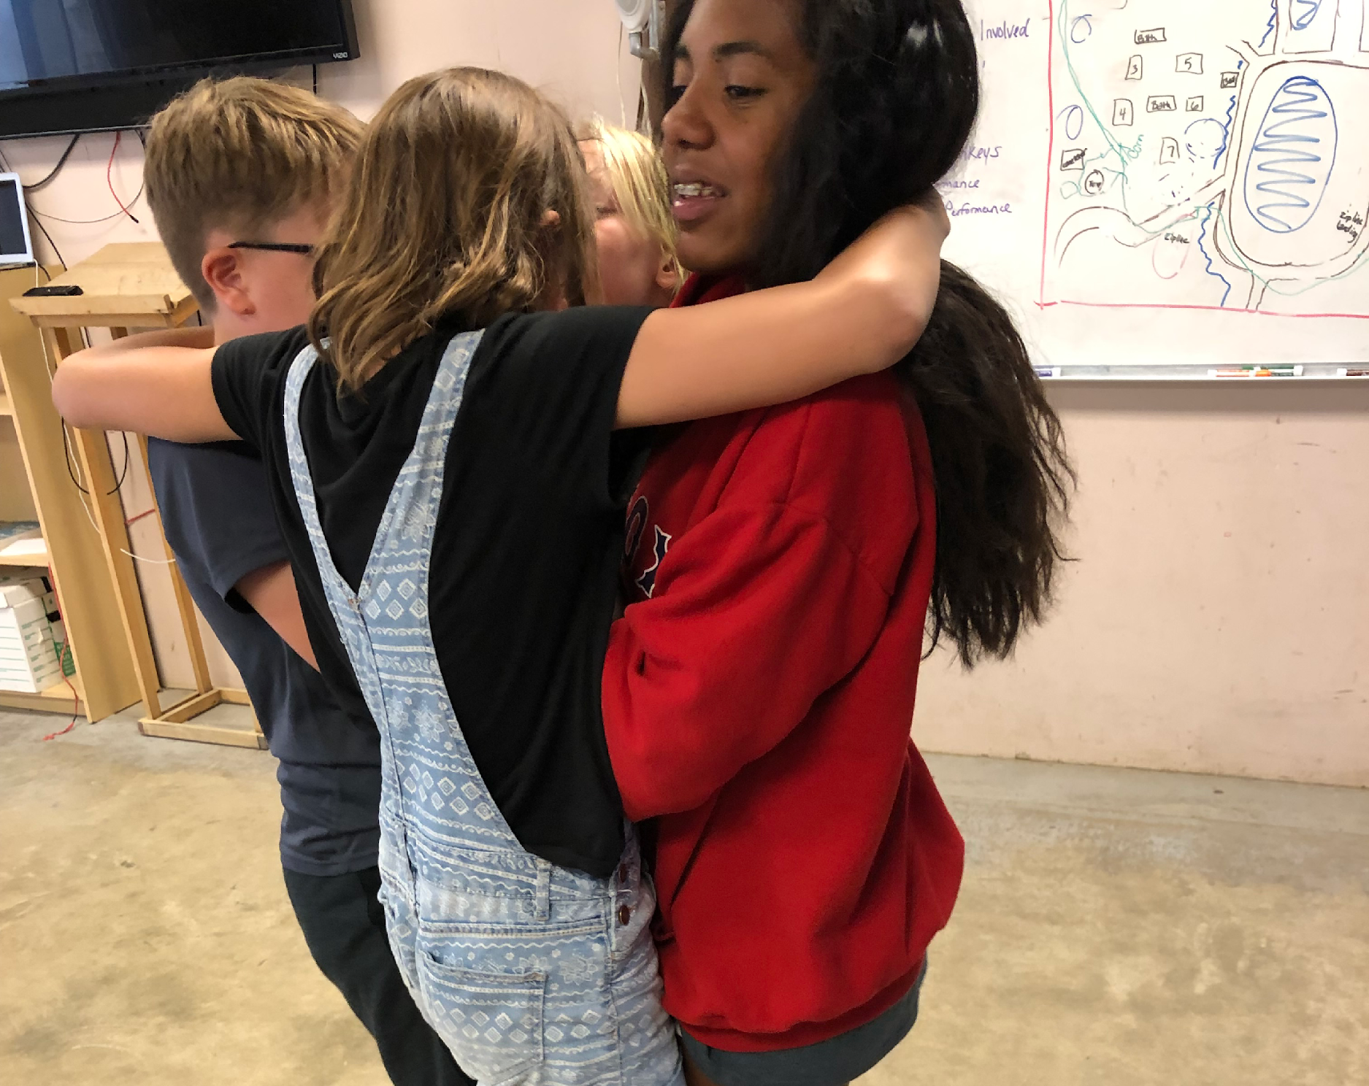
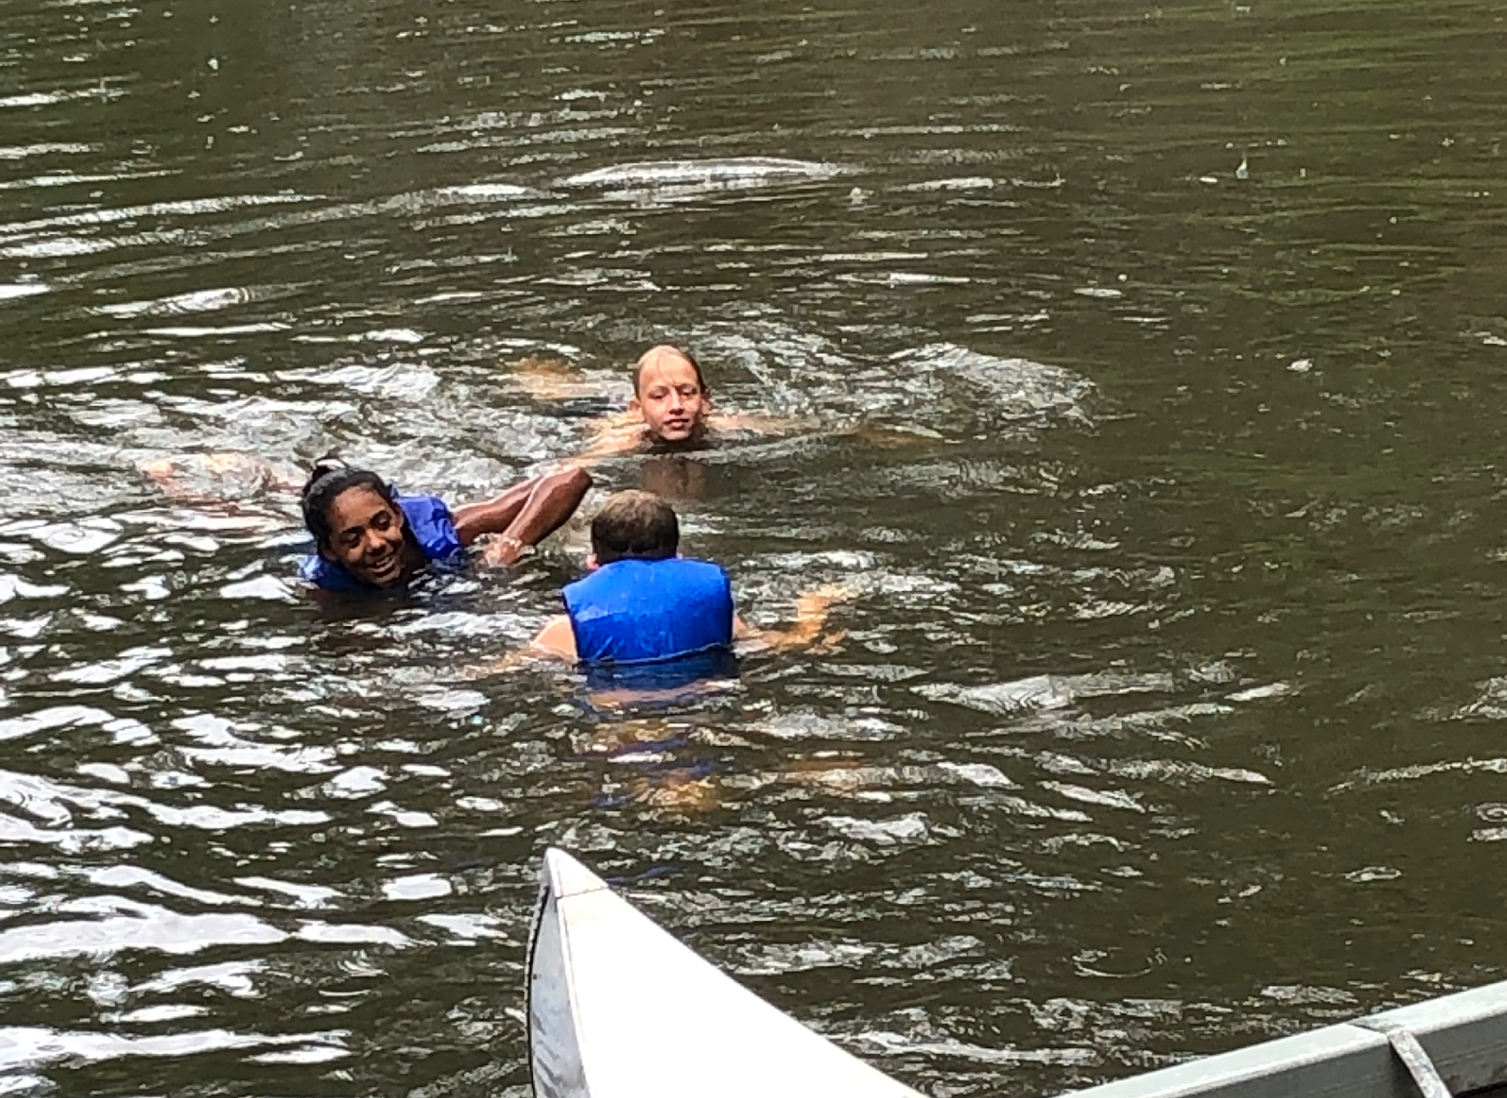
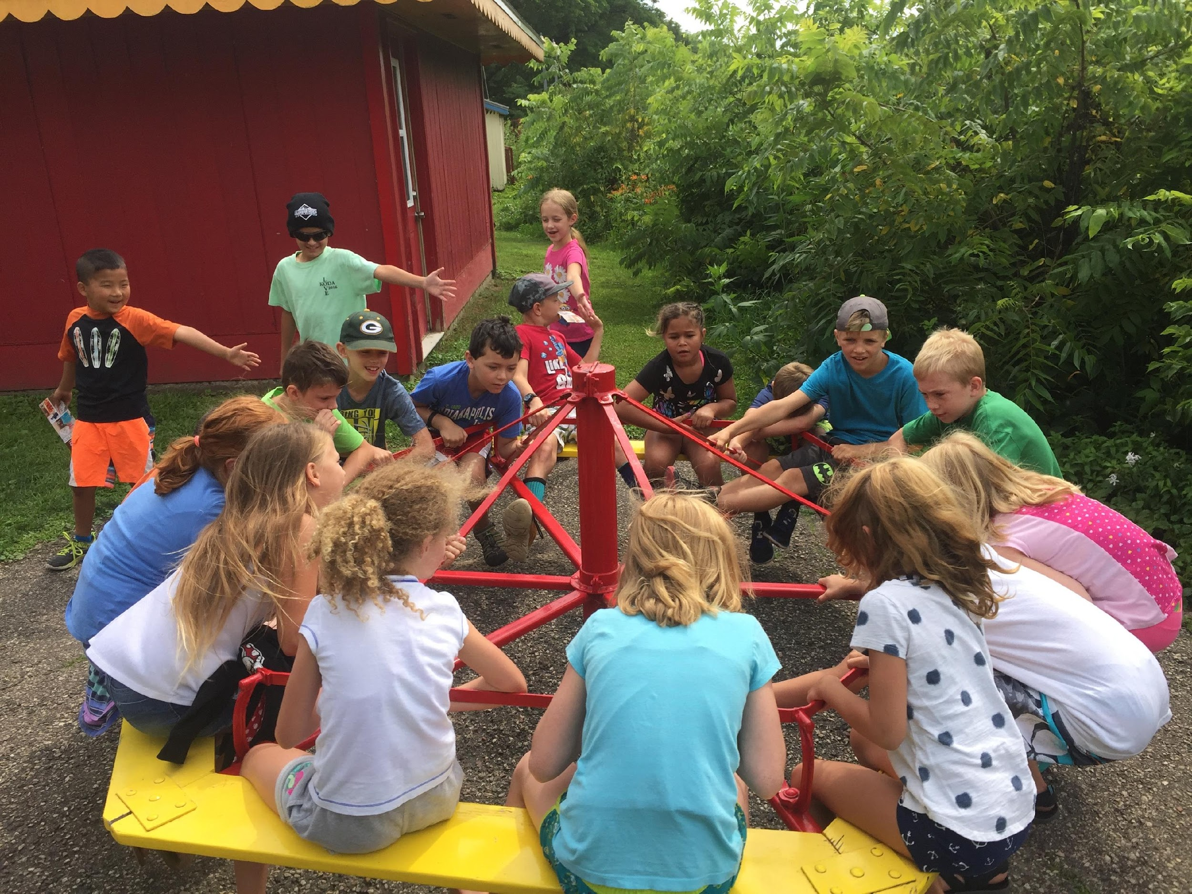

Slide 22
Contact Information
Bert Pickell
bert@ourbestus.org
Whatsapp: 317-966-2718

