Slide 1
CODA International
Millie Brother Scholarship
How To Build a Scholarship

Slide 2
CODA International Millie Brother Scholarship
The Millie Brother Scholarship is an annual scholarship awarded to hearing children of deaf adults to help them pursue their post-secondary education.
Since 1990, the scholarship has expanded to include applicants from several dozen countries, including the USA, South Korea, Japan, Nigeria, Ghana, Uganda, South Africa, New Zealand, England and more.
The award has grown from $300 to up to $3,000 per recipient. Each year we select about five recipients after a thorough application process that assesses need and impact alongside academic and personal achievement.

Slide 3
Scholarship Design and Implementation
Build Application
Solicit Applicants
Review and Selection

Slide 4
Build Application
What we ask for:
Background and education information, noting financial need
School transcript
Two letters of recommendation
List of honors and activities
Essay describing how having deaf parents shaped your life and goals, including a description of your career aspirations
Over the years our application has taken many formats, including a paper application, a Google form and our current online application using the customizable database software Knack.
Each year we assess our questions to ensure they align with our goals. In recent years we have shifted to a greater focus on need, so we have asked applicants to describe any financial challenges they have and how this scholarship would impact their ability to pursue further schooling.
*See attached application for reference.

Slide 5
2. Solicit Applicants
Application cycle tips:
Promotion: We use social media, including Facebook pages for regional Coda groups, to get the word out. We also invite previous applicants to reapply.
Reminders: Prior to the application deadline we send frequent reminders to prompt applicants and letter writers to submit all materials required.
Typically our application cycle runs for two months between 1 January and 28 February. All application materials must be received before the deadline for the application to be considered complete.
Our application is open to hearing children of deaf adults who is or will be a student at an undergraduate institution within the following year. Previous recipients are not eligible to reapply.

Slide 6
3. Review & Selection
Application ratings:
We ask other Codas to volunteer to help us rate applicants on a 1-10 scale in the following categories:
Essay organization
Essay content
Essay creativity
Letters of recommendation
Transcripts
Impact
Overall score
Special (voluntary rating)
Applications are scored in two rounds. During the first round, each application is rated separately by two of about 8-10 reviewers. The scholarship committee compares the average scores for each applicant to identify our top 10-15 finalists, watching for outliers in scoring.
During the second round, all finalists are scored by the same five reviewers. We then use those scores to identify our 3-5 recipients.
Awards are paid directly to the college/university of the recipient.

Slide 7
Tips for Success
Start early and stay on top of your email inbox: Application challenges will arise – both for the committee and the applicants – and it’s easier for everyone if they are addressed immediately.
Solicit a diverse group of reviewers: One of the reasons we assign reviewers in pairs is to identify and eliminate biases in scoring. We are also cognizant that, on occasion, personal conflicts will leave some reviewers unable to complete their ratings, and keep back-up reviewers on hand to fill in.

Slide 8
Challenges and Opportunities for Growth
Technology/cultural barriers: Some applicants and letter writers are unfamiliar with or unable to access the application on our current online platform. We work hard to troubleshoot these issues as they arise and extend leniency in application requirements as needed.
Soliciting applications: Our sourcing is limited in some countries and impacts the number of applicants we attract from those regions. In the future, we are hoping to partner with deaf and Coda organizations around the globe to further our reach as an international scholarship opportunity.

Slide 9
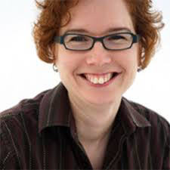
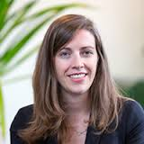
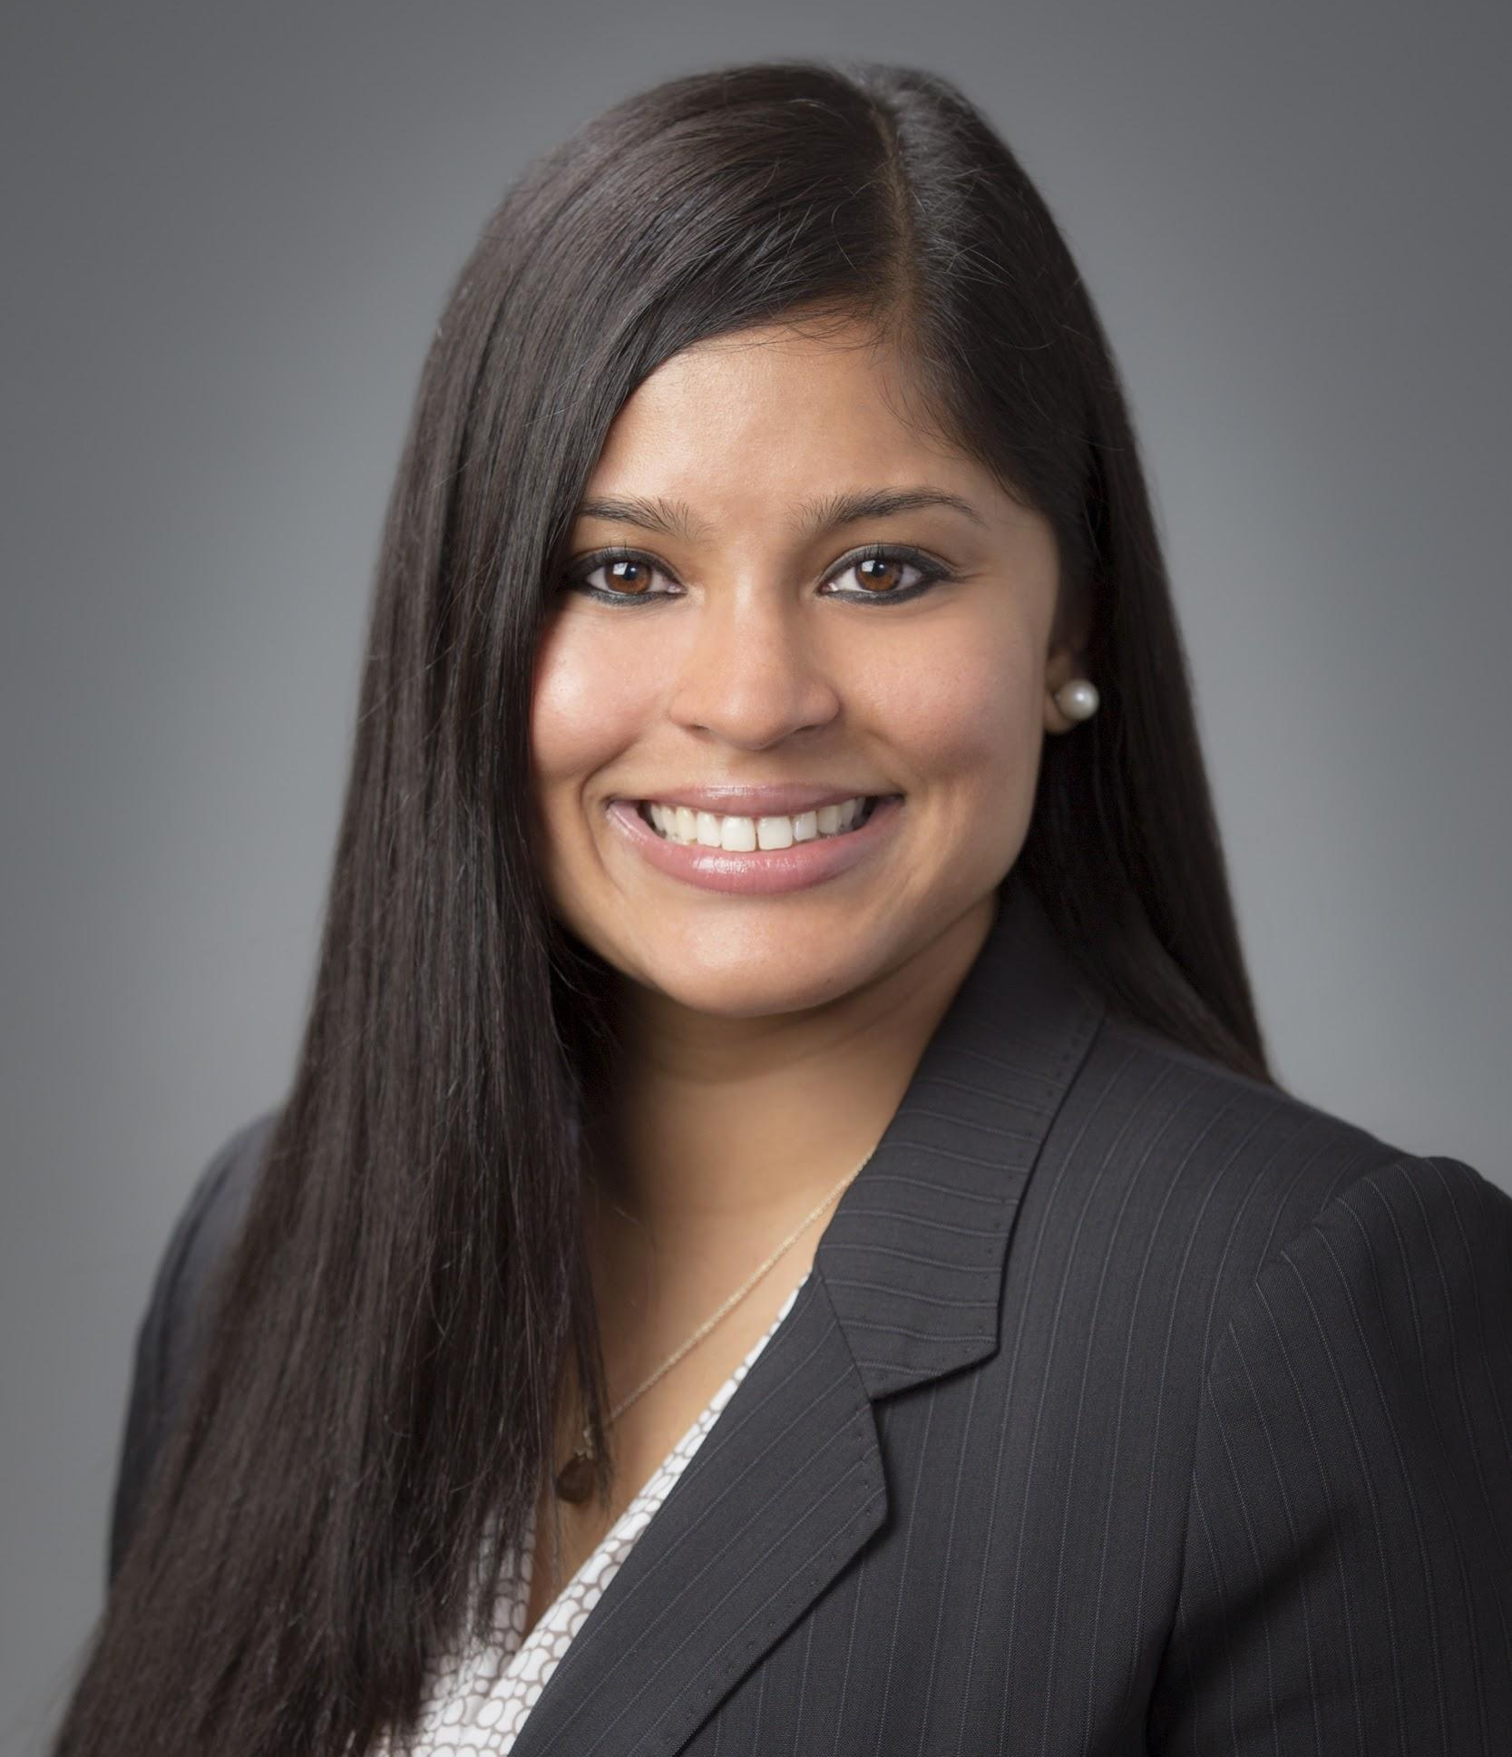
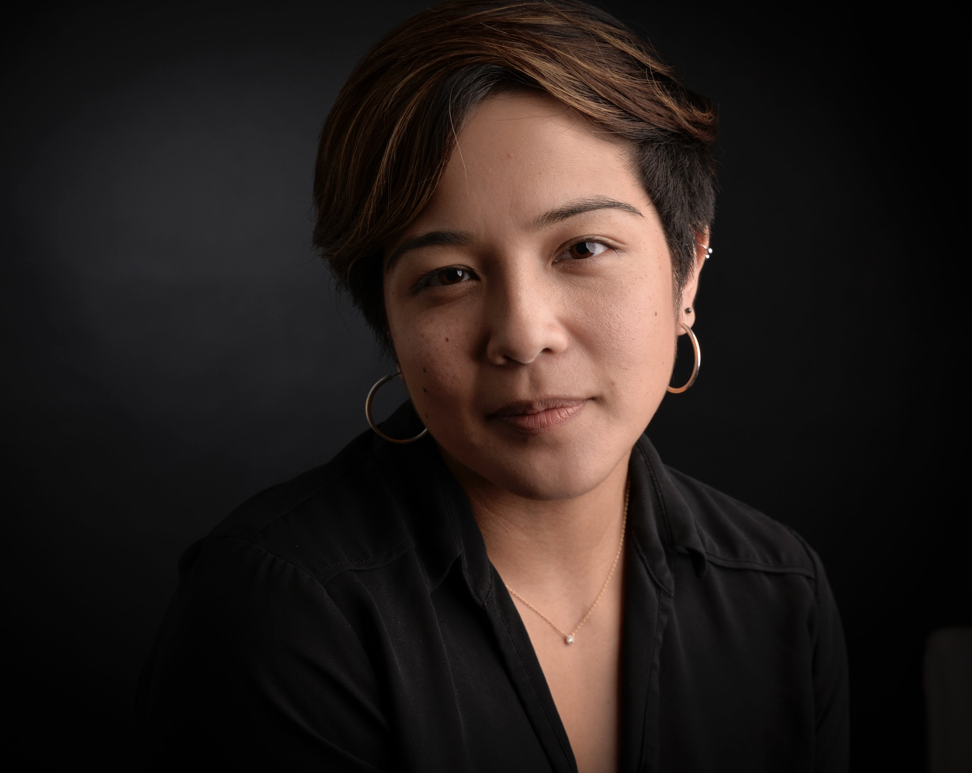
Any questions?
We are happy to help: scholarships@coda-international.org
Committee Co-Chairs
Jennie Pyers
Naomi Caselli
Su Kyong Isakson
Trisha Phadke
Kristina Miranda
Kayla Canne
Kiana Gonzalez

